Slide 1






Mentorship program
SUMMARY
DASHBOARD
Khuat Bao Nguyen

Slide 2
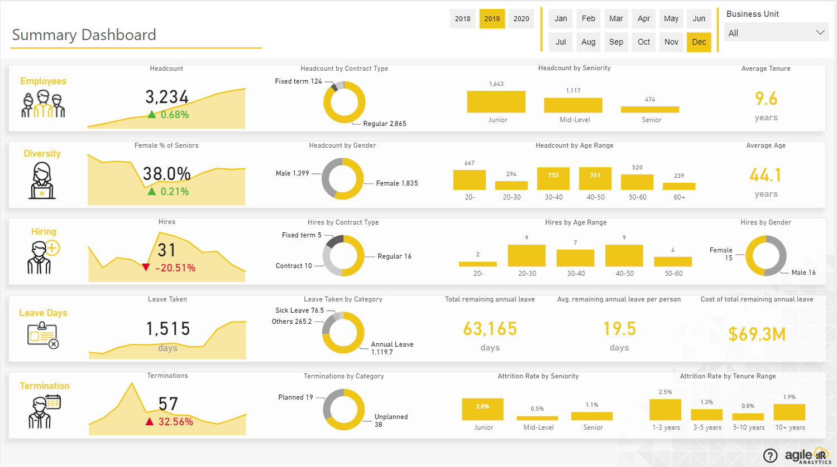
Summary Dashboard Page

Slide 3



Approach
01
02
Brainstorm
Design Database
Mentorship program

Slide 4
Brainstorm
1
Scan Page
2
Define Tables

Slide 5
Scan Page

Slide 6
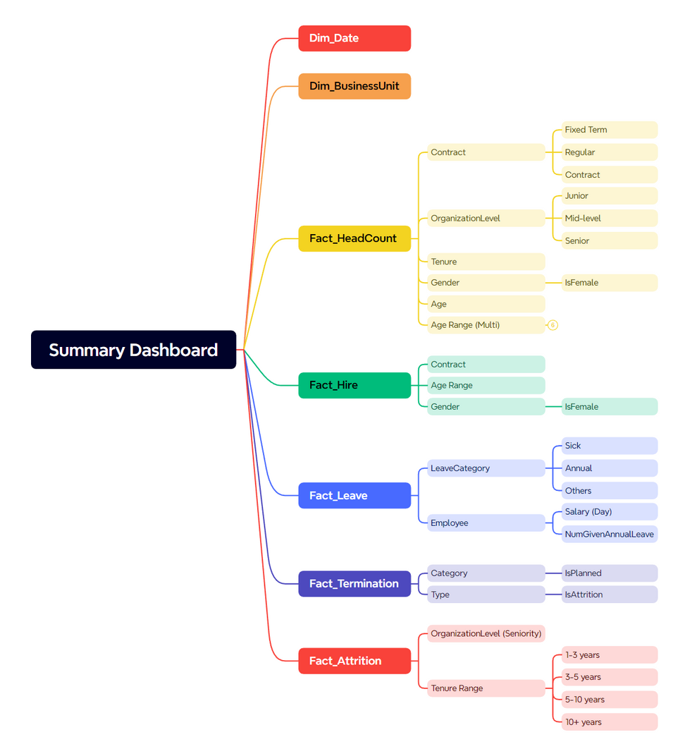
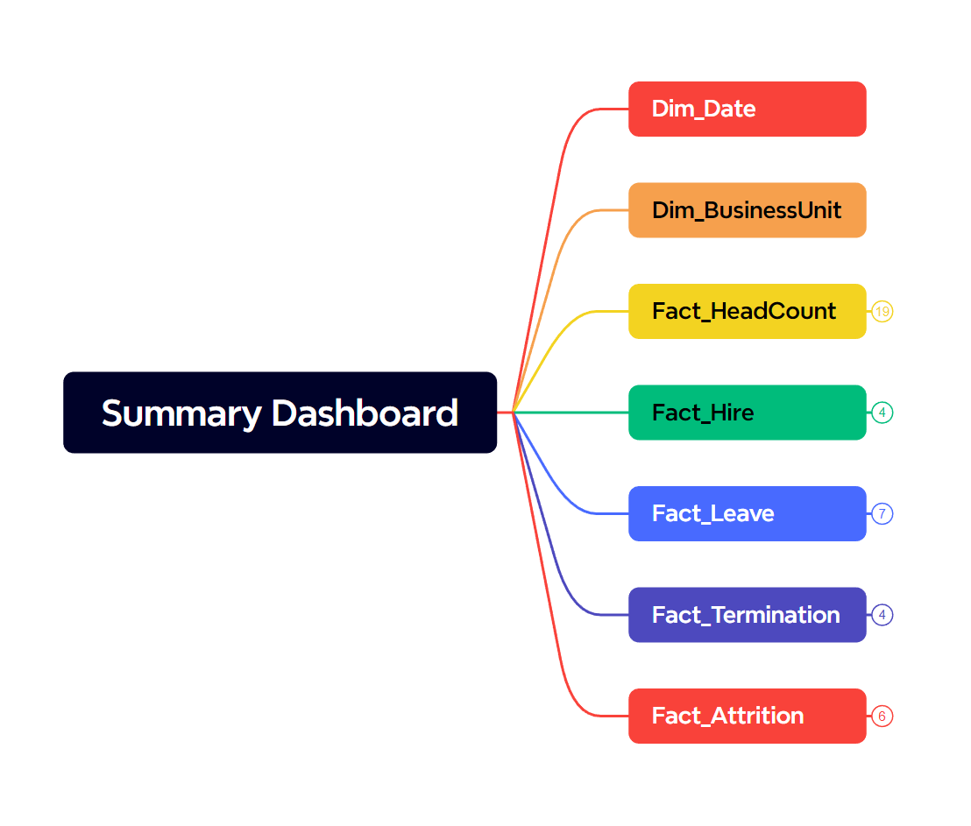

Slide 7
Define Tables

Slide 8
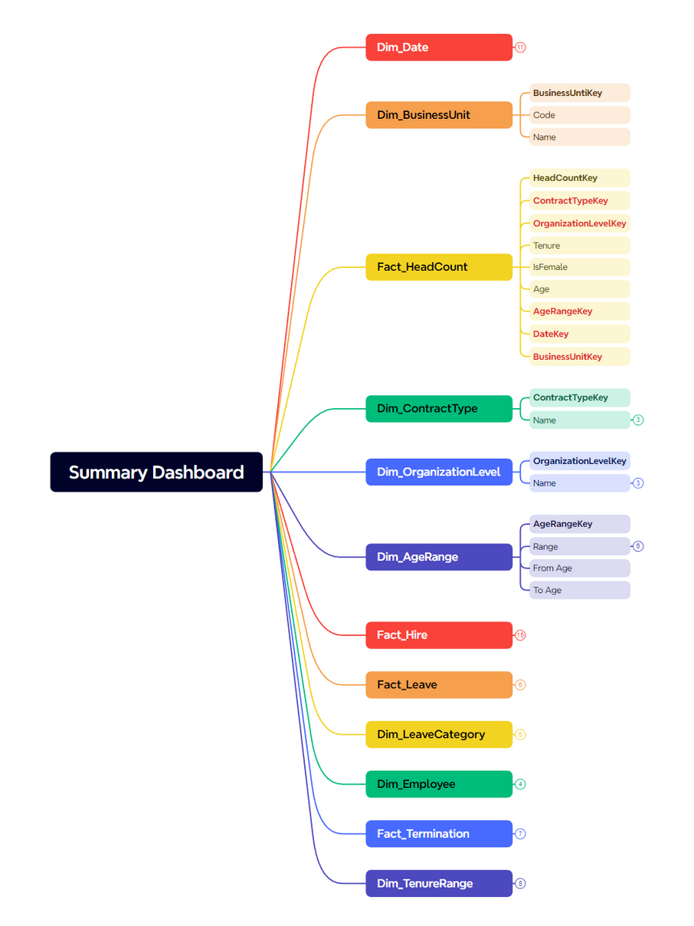
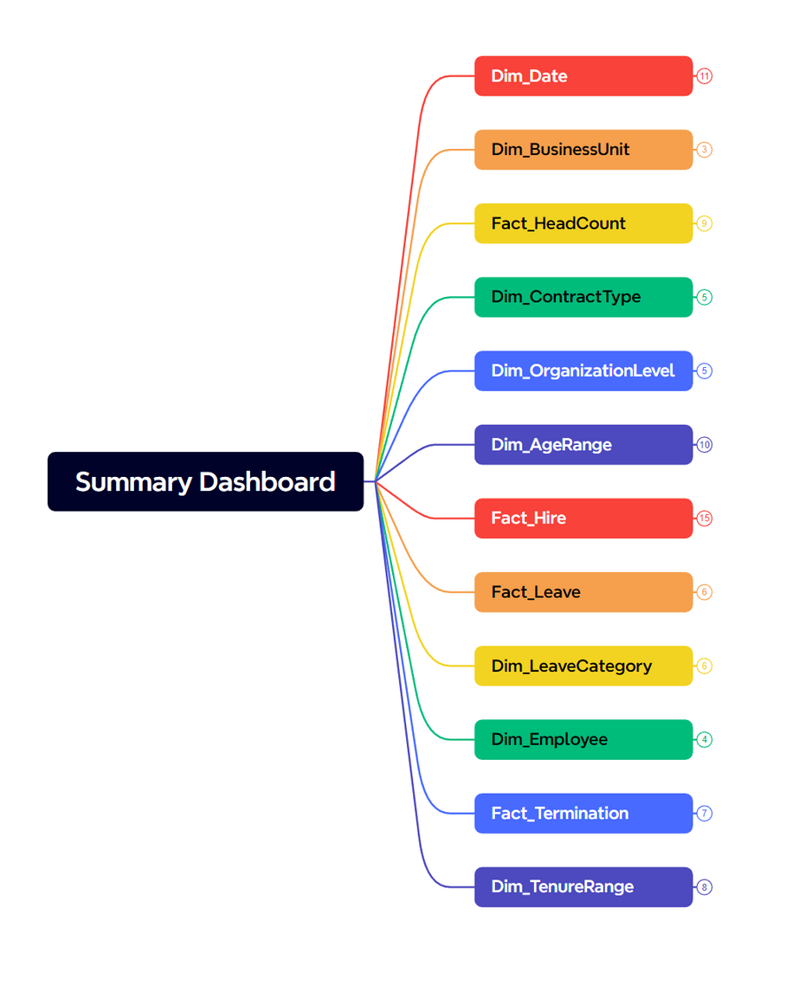
All Tables: https://drive.google.com/file/d/1HQS6j9nXRZeO6LForP4RKSd0zgsFjwd2/view?usp=drive_link

Slide 9
Design Database
1
Overview
2
Details

Slide 10
Overview

Slide 11
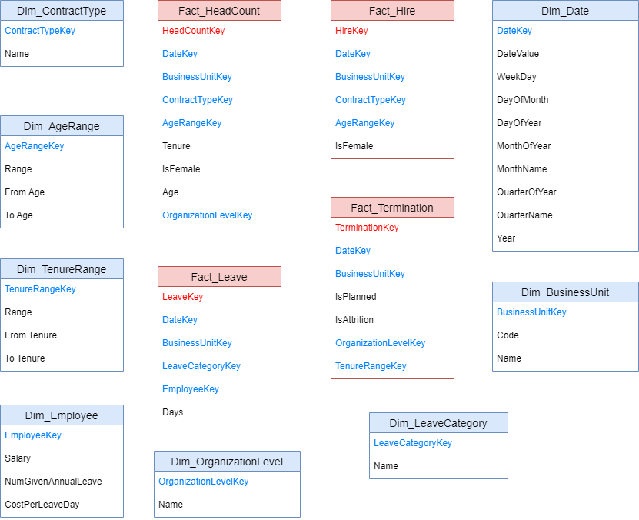

Slide 12
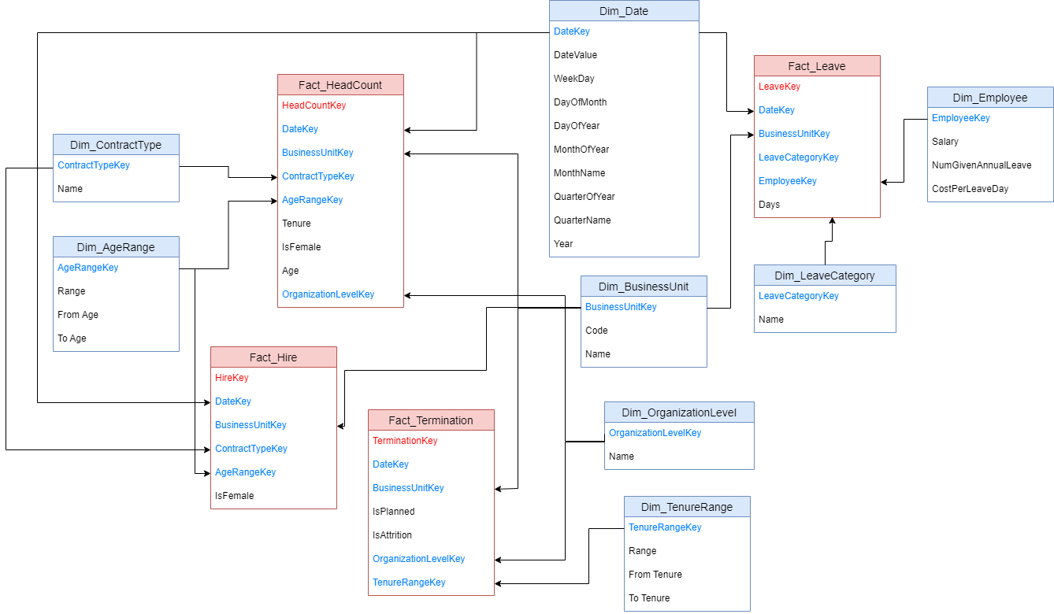

Slide 13
DETAILS

Slide 14
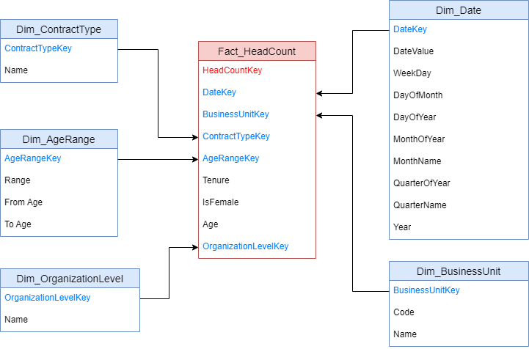
Fact_HeadCount

Slide 15
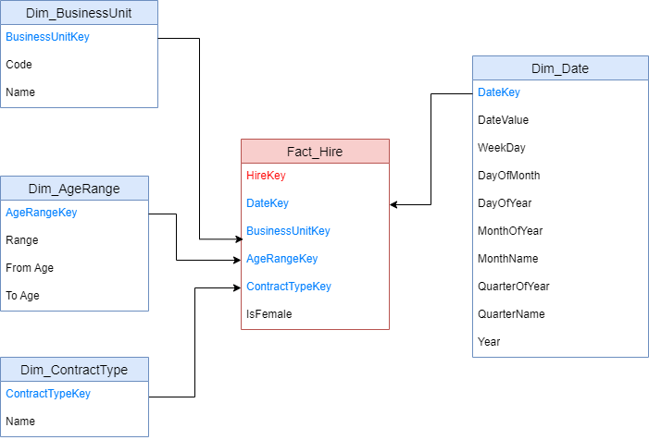
Fact_Hire

Slide 16
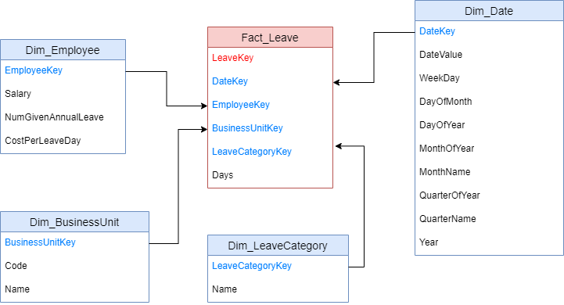
Fact_Leave

Slide 17
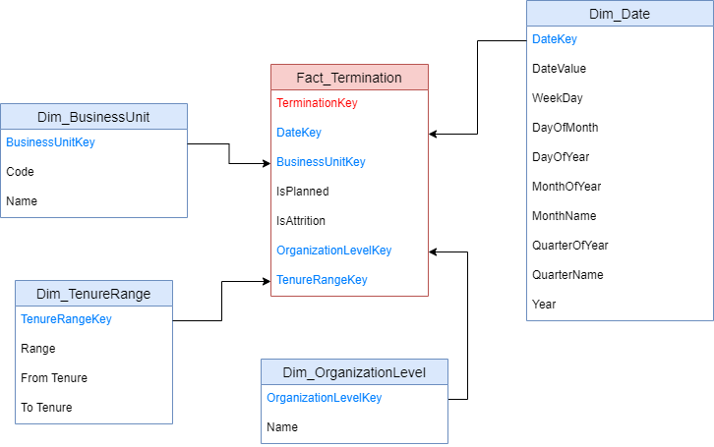
Fact_Termination

Slide 18


Thank you
I really appreciate your time.

